Slide 1

Team Members:
1. Nguyễn Trực Cường - 20215005 (Leader)
- Design the application’s main UI using FXML and CSS.
- Implement JavaFX controllers for the application’s components.
- Design and implement model classes(Piano, PianoKey, Recorder,…).
- Review team member codes.
- Prepare texts and image resources for application.
- Prepare report & presentation.
- Integrate Apache Maven build tool into the project.
2. Phạm Thành Công - 20194494
- Design the help menu.
- Improve UX.
- Provide suggestions for Class Diagram and Use Case Diagram.
3. Đặng Minh Chức – 20215001
- Provide suggestions for Class Diagram and Use Case Diagram.
- Prepare demo video.
4. Khổng Lê Cường - 20215004
- Prepare piano sound data
- Research audio playback methods in Java.
- Add new music styles to the application’s setting.
- Provide suggestions for Class Diagram and Use Case Diagram.
Topic 10:
Electronic Piano

Slide 2




Problem statement
Physical Piano

Slide 3
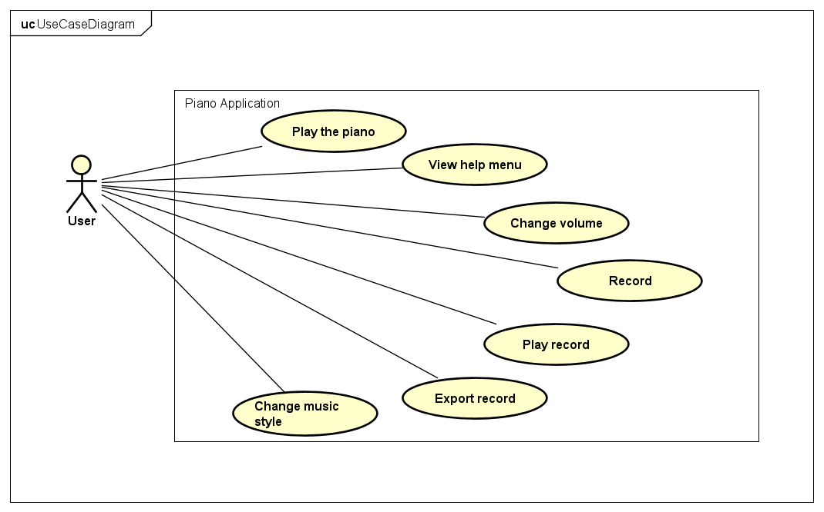
Use case diagram

Slide 4
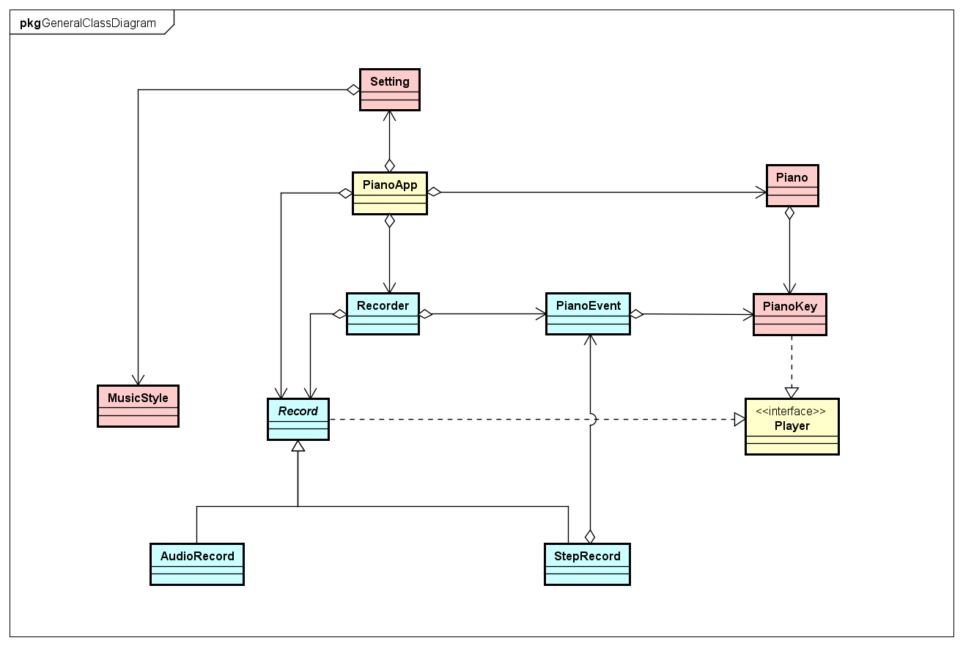
General class diagram

Slide 5
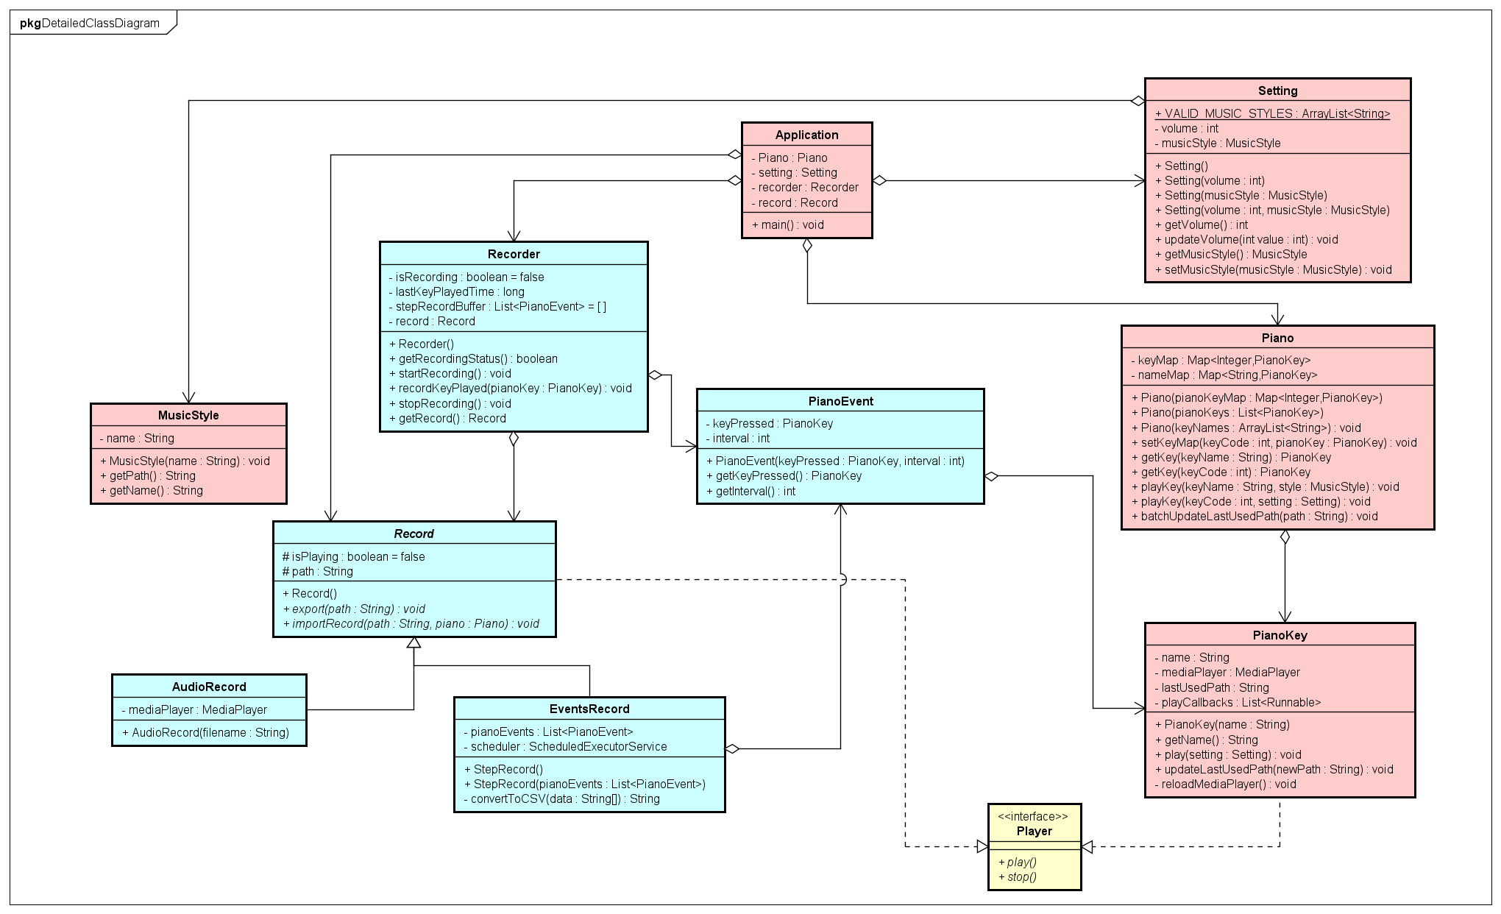
Detailed class diagram

Slide 6
Detailed class diagram
Aggregation

Slide 7
Detailed class diagram
Inheritance & Polymorphism

Slide 8
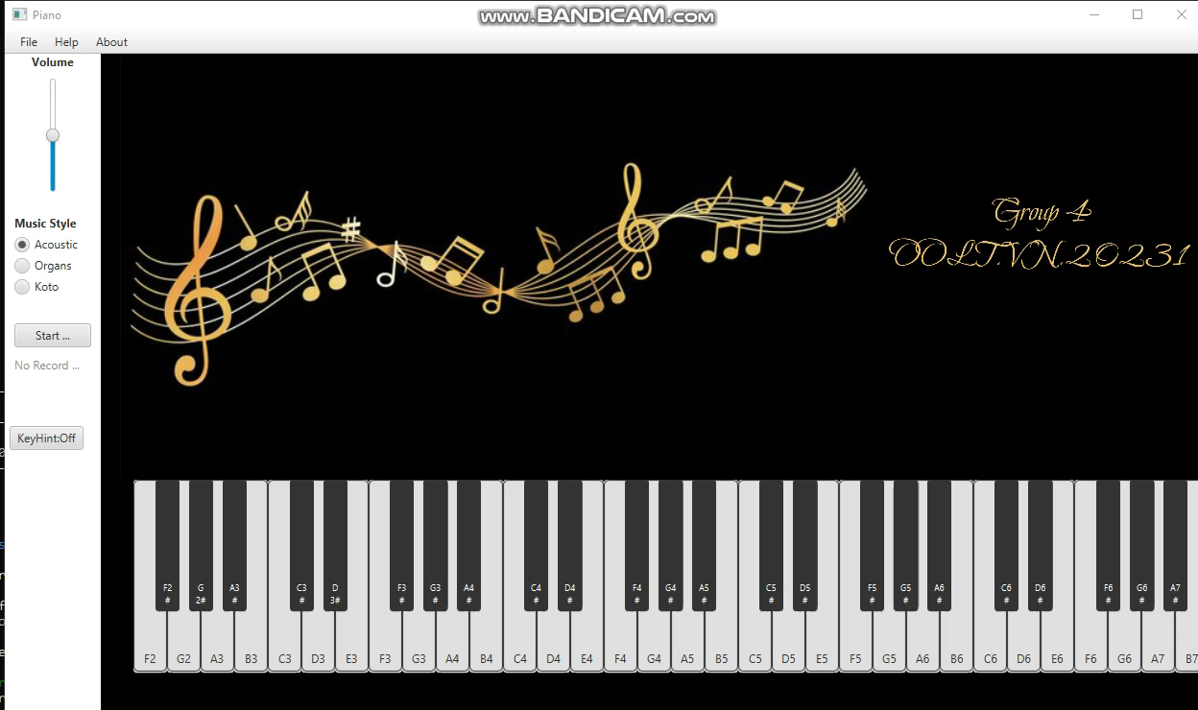
Demo

Slide 9
Thanks for listening!

Slide 10
Use case diagram
02

Slide 11
01
02
03
04

Slide 12
01
Problem statement

Slide 13
Use case diagram

Slide 17
65
25
85
30

Slide 18
86
64
49

Slide 20
02
02
02
02

Slide 22
03

Slide 28
04

Slide 29
01
02
03
04

